Slide 1

Apache Maven basics
Ivan Ruskevich
for JavaGuru.lv

Slide 2
What Maven is
Apache Maven is a software project management and comprehension tool.
Based on the concept of a project object model (POM), Maven can manage a project's build, reporting and documentation from a central piece of information.

Slide 3
Main concepts
Project
Project Object Model (POM)
Artifact
GroupId
Dependency
Plug-in
Repository
Snapshot

Slide 4
Key features
Simple project setup
Superior dependency management
Able to easily work with multiple projects at the same time
A large and growing repository
Extensibility
Model based builds
Coherent site of project information
Release management and distribution publication

Slide 5

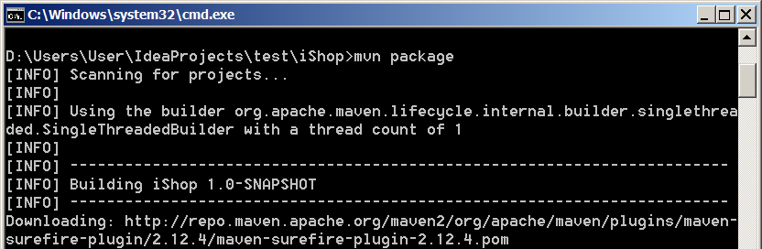
Maven build lifecycle
validate
compile
test
package
5. integration-test
6. verify
7. install
8. deploy

Slide 6
Maven setup
1. Download and extract Maven from
http://maven.apache.org/download.cgi
2. Make sure the JAVA_HOME variable is set:
e.g. C:\Program Files\Java\jdk1.7.0_51
3. Add the MAVEN_HOME variable:
e.g. C:\Program Files (x86)\Apache\Maven
4. Update the Path variable: add Maven bin:
%MAVEN_HOME%\bin

Slide 7
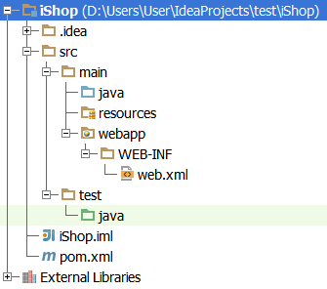
Directory structure

Slide 8
Pom.xml
<project>
<modelVersion>4.0.0</modelVersion>
<groupId>lv.javaguru.java2.iShop</groupId>
<artifactId>iShop</artifactId>
<version>1.0-SNAPSHOT</version>
<packaging>war</packaging>
<dependencies> … </dependencies>
<build>
<resources> … </resources>
<testResources> … </testResources>
<plugins> … </plugins>
</build>
</project>

Slide 9
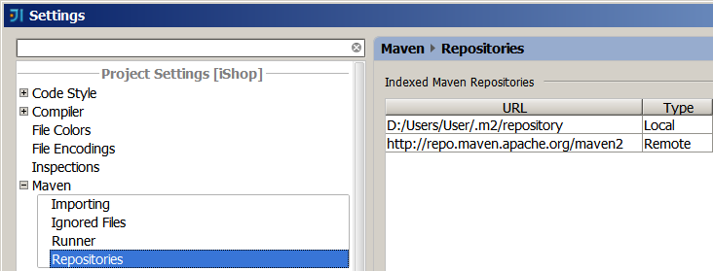
Repositories
Local
Remote

Slide 10
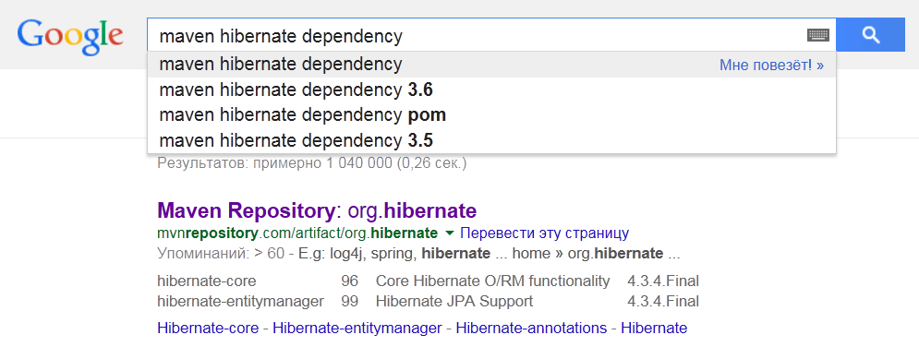
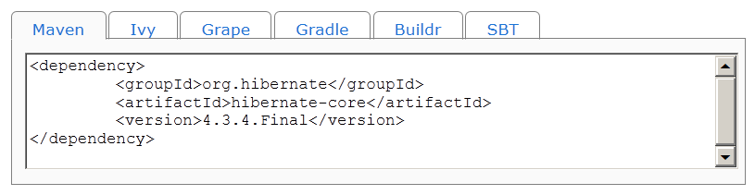
Adding dependencies

Slide 11
Congrats
From now on
we're on Maven!

